Slide 1

MISSION TO MARS

Slide 2
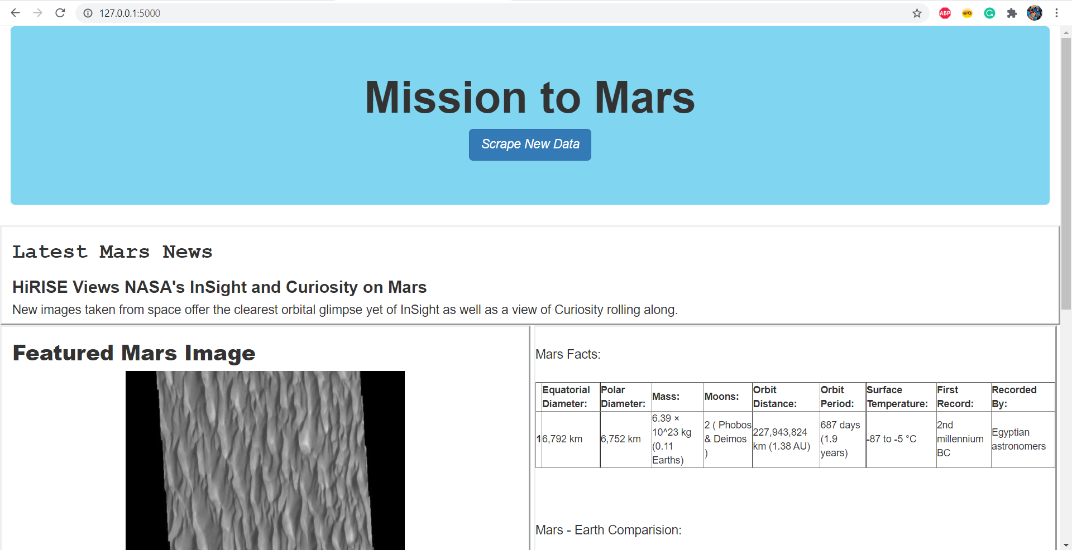
MISSION TO MARS: Initial Web page

Slide 3
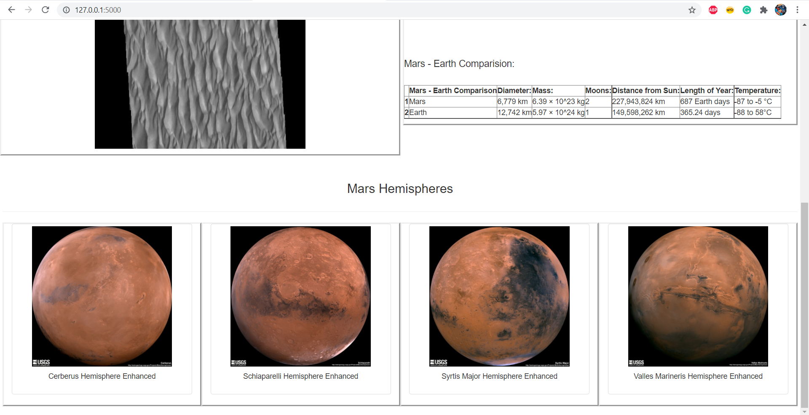
MISSION TO MARS: Initial Web page

Slide 4
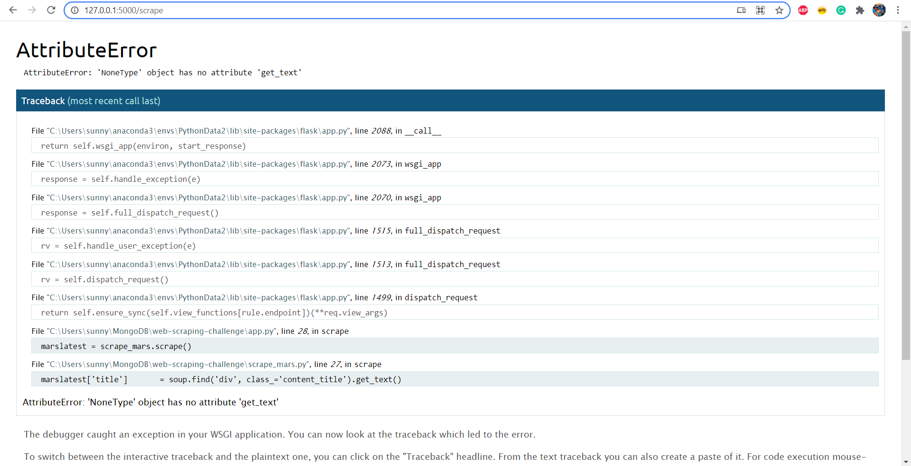
MISSION TO MARS: unsuccessful scraping instance
The scraping function for website https://redplanetscience.com/ is not stable. I have seen multiple test iteration where a failure was recorded.
I gave it a try a couple of minutes later and it worked as expected.

Slide 5
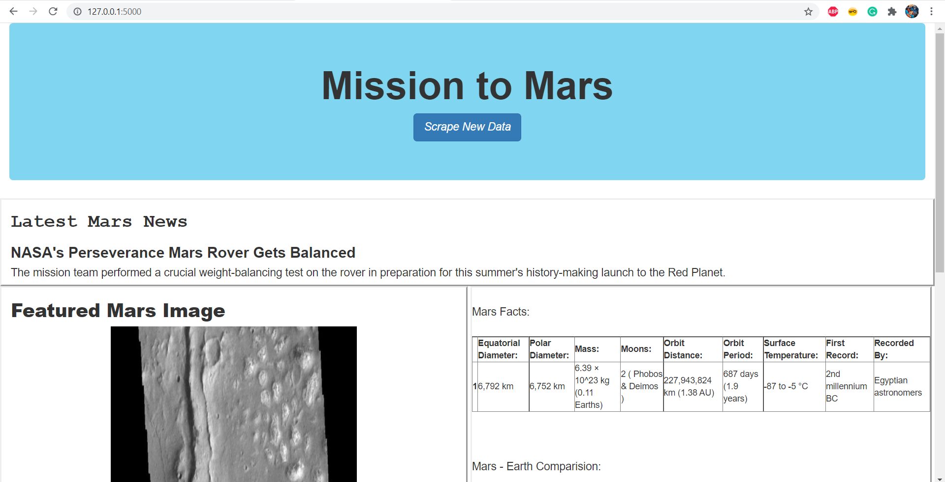
MISSION TO MARS: Successful scraping instance

